Slide 1
Business Analysis
Digital – R1.2 Requirements Approach
Sherry McMillan
Sr Manager, Business Analysis
February 3rd, 2022

Slide 2
Recommendations – Immediate Next Steps
  Define and train out ownership for BA Responsibilities
  Improve the efficiencies of meetings
  Transparency and tracking of deliverables
  Both CWB and Temenos Teams working together.

Slide 3
What Does Success Look Like
      We have a common understanding of
        What the Business Need is
        How the solution is filling it
      All stakeholders can easily find the answer to the points above
        We don’t need to ask: “What did we decide?”
        The answers are complete, correct, and consistent (no missing or conflicting documentation)
      Dev has what they need to code
      QA has what they need to test
      We all have what we need to support and maintain (or even enhance) the solution in the future.

Slide 4
What Can We Do Right Now?
  PREPARATION
  Temenos to give at least 2 business days lead time on meeting agendas
    The goal for the meeting, and each agenda item, is clearly stated
    The Temenos team in the room to understand the base product and have the right people in the room to answer questions.
    Temenos to provide supporting existing documentation for the agenda items.
  FACILITATION
  Start with the goal of the meeting/agenda item.
  Focus on the User Task/Experience – Center on how it relates back to the stated business need. Articulate the business need as the user goal. Review the story and describe if/how that functionality meets the user goal.
    As feature documentation does not cover end-to-end flows, provide consistent user journeys.
  Show the supporting materials – a picture is worth a thousand words.
  Where edits have been done since the last meeting, focus on the change and, again, state the goal.
  Where the conversation is resolved by standards stated elsewhere, refer the conversation to those standards; do not try to build or change standards in these meetings.
  OTTB features, for the most part, have identified gaps. Therefore, focus the discussion on the gaps with a goal for agreement on how to fill those gaps.
  User Stories to be written after above discussions have been had and both teams are aligned.
  UX flows to follow initial story/high level requirements, with final mocks delivered with or after the final story approval.
  COMMUNICATION
  Use agreed-upon terms for requirements and for feature states. For example, Out Of The Box or Pre-existing Customization? See the glossary (slides 8 & 9).

Slide 5
Ownership of BA Tasks and Deliverables
Owned by: Digital BA Lead See also Digital – Requirements Workflow – Current and Future State – Overview
Note: This principle can be applied across disciplines - UX etc. Glossary. Slides at the end of this deck
Case | Temenos BA |  | CWB BA | CWB BA | Notes
 | Task | Deliverable | Task | Deliverable
Spotlight/ Infinity Out Of The Box (OOTB) | *Understand the product in detail. * Demo OOTB Have the right people in the meeting for Q&A | *Provide Existing Requirements. *Recorded Demo. | *Work with Business to verify that OOTB will meet the need. (Ultimately a Business decision). *Emphasis on User Task/Goal | Trace Temenos Deliverables to CWB Business Need. | *Note: QA is an important consumer of this information. *Storage location TBD.
Spotlight/ Infinity – With Customization | *Understand the product in detail. * Demo OTTB. Have the right people in the meeting for Q&A *Document Customization, e.g. User Story and Mock-up | *User Story that covers the modification. *Mock-Ups *Recorded Demo if modification jumps off of unchanged design with no requirements. * User Journeys | *Understand the R1.1 product in detail. *Verify that customization is necessary *Review, provide feedback on, and ultimately validate Temenos requirements. *Trace Temenos Deliverables to CWB Business Need. *Emphasis on User Task/Goal | * Trace Temenos Deliverables to CWB Business Need. *Transition to Operations (TTO) | * This Case could be broken down further into modification from OTTB and modification from prior release, e.g. R1.1 *Note: QA is an important consumer of this information. *Storage location TBD.
Spotlight/ Infinity New Feature | *Intake and understand the Business Requirements. *Design solution to meet CWB standards. *Demo New Feature once coded. | *User Story for the New Feature *Detailed Design and Functional Requirements as needed. *Mock-Ups | *Work with Business to understand and document the new feature. *Available for Q&A with all impacted stakeholders. *Emphasis on User Task/Goal | *Business Requirements * Trace Temenos Deliverables to CWB Business Need. *Transition to Operations (TTO) | May also include deliverables for other affected Implementation teams. *Storage location TBD.
Not a Temenos Product - e.g. Integration | TBD | TBD | *All necessary for requirements creation *Work with the consumers of the requirements to understand the level of detail needed applying BA Best Practices. *Emphasis on User Task/Goal | *BR, FR, NFRs and other BA artifacts as needed. *Traceability Matrix. *TTO | *Storage location TBD.

Slide 6
Prep work – Feature discussions – Temenos Scope
What is already happening and will continue to be tracked closely (Actionee: Harish)
  Working closely with technical team on any feasibility POCs, as applicable (Design / functionality)
  Working with Product team / R1 team as needed, for preparation towards feature discussion
  Sharing the agenda 24-36 hours prior to session with all stakeholders
Additional opportunity for improvement - Actionee: Temenos (Harish and Chirag)
  Work on an internal checklist for BA and UI-X team; this checklist is expected to help in team’s preparation for feature discussion and later for the documentation/design for stories
  Work with Product team to get the ‘Delta’ of features between 20.07 and 21.04 where applicable, for reference

Slide 7
Prep work – Feature discussions – CWB Scope
What is already happening and will continue to be tracked closely: In preparation for demo from Temenos (during ‘Feature discussion’ session), CWB is suggested to -
Review existing material – CWB BA
  Note: The references to the existing material is only for an understanding of feature. We understand that the documentation may not be sufficient. This is not an entry criteria into feature discussions. All feature discussions will continue to start with a demo and walkthrough of the feature to help us gather the gaps and requirements in detail.
Plan for internal discussions and reviews based on existing material so that Temenos BA can document the gaps post feature discussion
If there are any already ‘known’ technical/vendor dependencies that can impede further discussion on a feature, PM- CWB can work with CWB BA and Temenos BA and PM to (re)schedule the feature discussion.

Slide 8
Appendix
Glossary
Requirements Discussions – Agreements Actions

Slide 9
Glossary
Term | Definition
Out of the Box (OTTB) | The feature is available to all Infinity/Spotlight users.
Pre-existing (CWB) Aka: Prior Enhancement | The feature is available to CWB as of a prior release.
New Enhancement | The feature is currently available but does not meet CWB’s needs. A change to that existing feature is needed.
New Feature | The feature is not (yet) available to any Infinity/Spotlight users.
Note: If it’s helpful we can also break down what is not currently OTTB by what is unique to CWB and what will be available for all users (for Commercial support in Canada.) See the next slide.

Slide 10
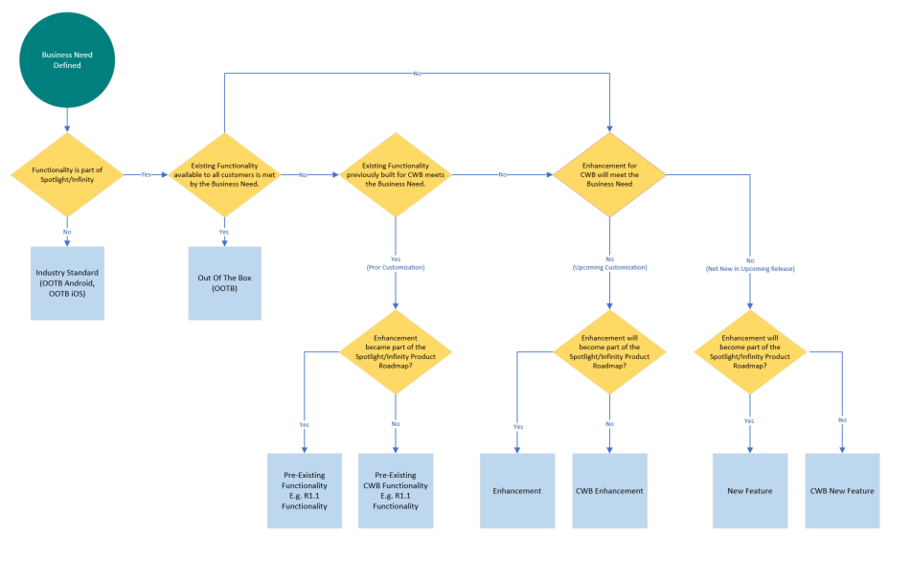
Glossary

Slide 11
Requirements Discussions – Agreements Actions
Source: email/follow-up from meeting on Jan 24th Niel Colinares, with Status column added
 | Recommendation/Challenge | Agreed Action/resolution | Status
1 | Preparation for the requirements gathering sessions –CWB needs to review the features(Req CorpBank EFT_R1.2 Refined & Conceptual view tabs), and determine the bank’s requirements for those features, prior to the scheduled call; Temenos BAs will need to be familiar with what is available OOTB for those features, as well as the related R1/R1.1 customizations | What was agreed: This was not concluded, it was agreed to continue the discussion within a smaller group. Summary of main ideas/pain points discussed so far: Level of preparedness for the sessions is insufficient – both Temenos and CWB The agenda needs to be determined well in advance and the right people need to be in the sessions at the right time but expect fluidity in the agenda/schedule Conundrum/cart before the horse scenario – do we look at what is out of the box/R1 customized and figure out the requirements or requirements are determined and documented first, and compare against out of the box/R1 customization. Not enough info/knowledge on what is out of the box/R1 customized for CWB to effectively determine gaps/requirements; Temenos BAs not in a position to write/complete stories coming out of the sessions as there are too many takeaways. How do we get to a steady cadence for creation/review/approval of stories and be able to meet dates | 02/03/2022 – The smaller group met; the result of those meetings are these slides.

Slide 12
Requirements Discussions – Agreements Actions
Source: email/follow-up from meeting on Jan 24th Niel Colinares, with Status column added
 | Recommendation/Challenge | Agreed Action/resolution | Status
2 | UI/UX design and review are currently in 2 steps; suggest these 2 should be combined into 1 step/session so that the design and review happen in the same session with both the CWB BAs and reviewer present, to reduce the amount of rework. | What was agreed: For complex designs or designs with substantial delta, avoid UI/UX discussions in the scheduled sessions, instead have a separate session between the CWB & Temenos UI/UX teams to work together on the design And once the design is complete return to the bigger group with the UI reviewers/approvers also in the room and finalize in the same session or sessions with the same group; as opposed to using the sessions only up to the review stage, and having a separate group undertake the final review/approval. This would help reduce iterations and rework. | On Slides 4 & 5
3 | Determine & align on components that even if not completed, should not hold review/approval of stories like: Messages Labels Reference to invision screens (case to case) Branding (case to case ) Certain UI components(case to case) Determine & align on components/work that do not need to be discussed in the sessions, either they are determined/decided off-line or just referred to standard rules e.g. fonts/colors/icons on UI, set due dates for delivery | What was agreed: Remove content (message text & labels) from the decision making/approval process and from discussions in the sessions Instead create placeholders and determine/decide text/labels offline (by the CWB related departments), with due dates as they need to be finalized before the related stories are taken up for development While in general content should be finalized before the story is taken up for development, agree with Dev that if there has to be changes to content (without any other impact e.g. screen layouts, logic, validations, etc), these will not be considered CRs. Avoid debates/discussions on those components that are covered in the branding guidelines/blanket rules. If during the demo certain components were not developed according to the branding guidelines it will be considered a defect and not a CR (unless the branding guidelines were changed mid-stream) NFR will be outside of the scope of the Requirements sessions , | Question: Does this need to be documented further and/or trained out?

Slide 13
Requirements Discussions – Agreements Actions
Source: email/follow-up from meeting on Jan 24th Niel Colinares, with Status column added
 | Recommendation/Challenge | Agreed Action/resolution | Status
4 | Determine and align on features that can benefit from all-day continuous daily sessions and adjust the schedule accordingly | What was agreed: For complex features like Account grouping where continuity of discussions is essential and no/reduced takeaways is critical to timely completion, all-day sessions will be scheduled. In addition consider concurrent sessions where there are no constraints on availability on resources required for a session (like only one of 2 parallel sessions needs the presence of a System Architect) | Question: Where do we currently stand on this? I believe we were leaning toward break-out sessions and shorter rather than longer meetings.
5 | Tracking of the Requirements schedule on a daily basis by both the Temenos and CWB PMs. Determine and align on reporting for exceptions/slippages | What was agreed: Agreed on closer/daily progress tracking. Will leave this to the PMs Michael & Lalitha to implement | With Michael and Lalitha. BA providing supports by documenting deliverables in the Requirements Tracker. Pending – Jira Boards in the CWB Atlassian Cloud Instance for visibility and clear ownership. (With Sherry and the SDLC Tools project.
6 | Focus of the stories should just be on the delta from out of the box | What was agreed: Aligned in general that only delta should be documented in stories; leverage artefacts on existing functionality/feature that can help accelerate writing the stories like the original stories or even a recording of a demo. Consider on a case by case basis if no artefacts that can be leveraged exist In determining the delta to be documented R1 customization also needs to be taken into consideration (not just 20.07 vs 21.04 out of the box), so the delta is between R1 Customized and 21.04 where applicable | Covered in Slides 4 & 5

Slide 14
Requirements Discussions – Agreements Actions
Source: email/follow-up from meeting on Jan 24th Niel Colinares, with Status column added
 | Recommendation/Challenge | Agreed Action/resolution | Status
7 | Discussions on the requirements sessions should be focused only on the features scheduled; any other topics should be scheduled for another call | What was agreed: Aligned except in cases where all discussions on the scheduled topics completes ahead of time; leverage the opportunity that “everyone” is in the room to take up topics/issues that were not scheduled. | Question: Is any further action needed on this item?
8 | Other Topics Discussed | What was agreed: Except for changes to content (message texts & labels) as detailed in item 3 above, changes to approved stories (both additions and removal) are subject to approval of the scope control board, and will need to be logged. | Question: Does this need to be communicated/trained out to both teams? That is, does everyone understand that there are different approval statuses – Approved vs Conditionally Approved. For example, it needs to be clear when there are placeholders for content the story can be Conditionally Approved. The addition of that content does not constitute a change from approval or necessitate a CR.

